Slide 1
Scope screenshots

Slide 2
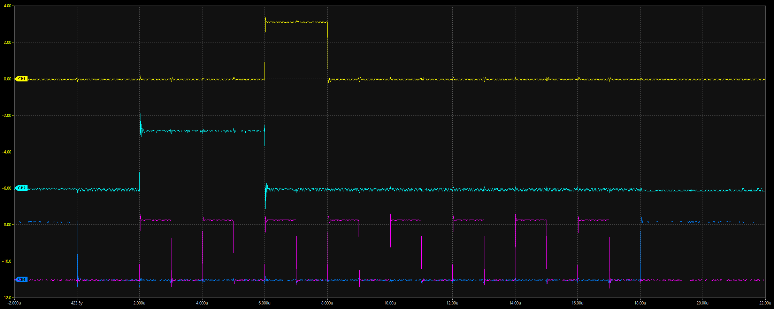
SPI comms between ADS and PIC

Slide 3
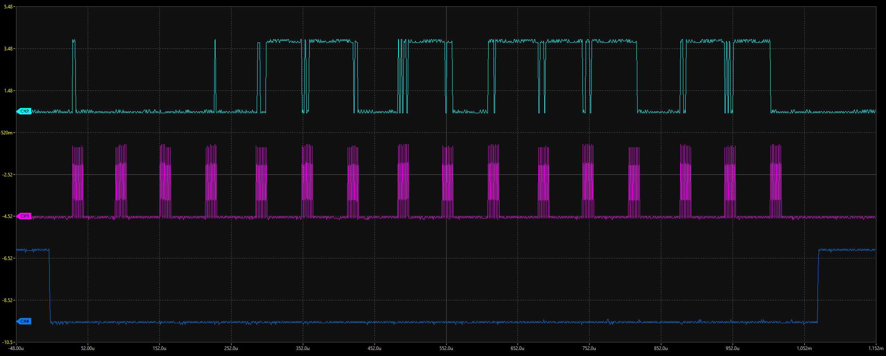
Working comms between ADS and PIC

Slide 4
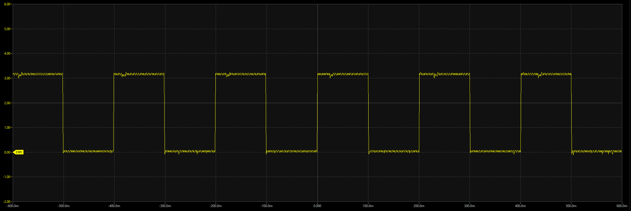
Measuring 100ms delay

